Slide 1
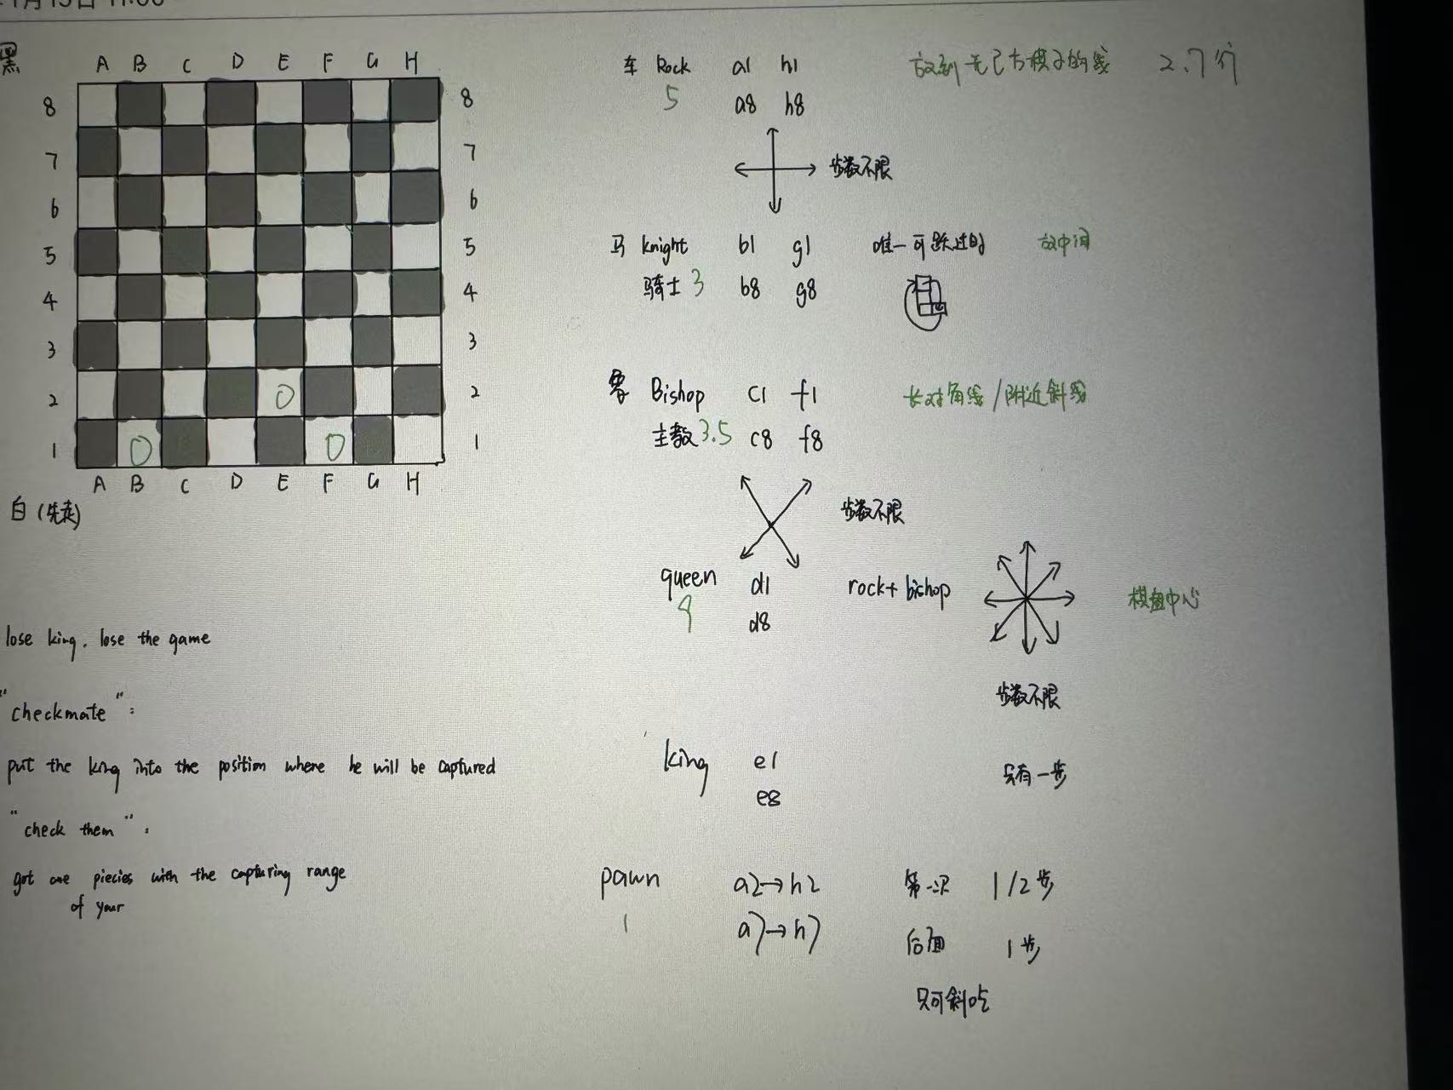
目标：将死对方的国王，即对方的国王处于被攻击状态（被将军），且无法通过走棋或吃子来摆脱这种状态。
To checkmate the opponent's king, which means the opponent's king is under attack (in check) and cannot escape from this state by moving or capturing.
经典规则（Classical）：90mins
快棋（Rapid）：10-60mins
超快棋（Blitz）：3-10mins
ELO RANK SCORE SYSTEM Magnus Carlsen

Slide 2
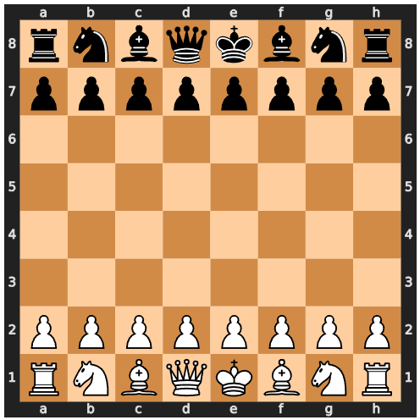
“1. e4 e5” mean
Opening:
Force development
Center control
Common types: Italian, Spanish
Middlegame:
Intense battles
Piece exchanges Attacks
Positional struggle
Requires: Strong calculation, tactical insight
Endgame:
Simplified position
Pawn promotion, king activity, piece coordination
"!" good move
"!!" very good move
"!?" a risky but creative move
"??" very bad move

Slide 3
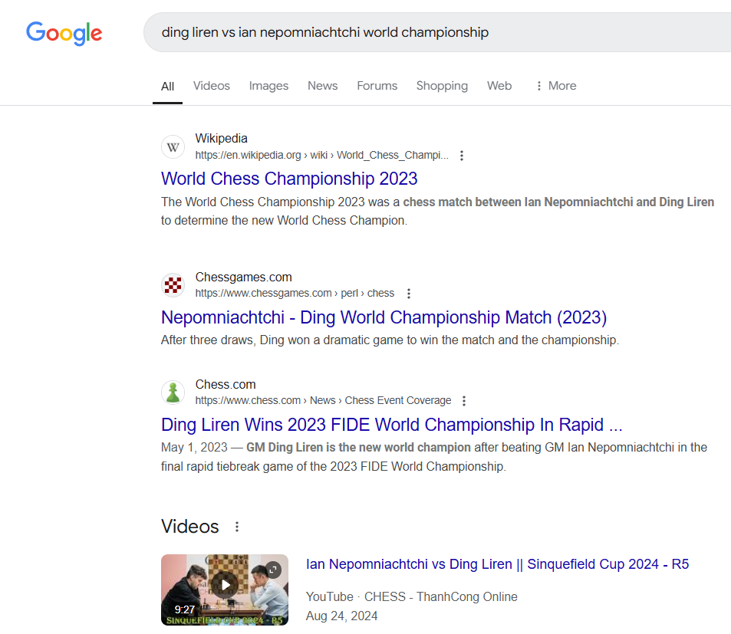
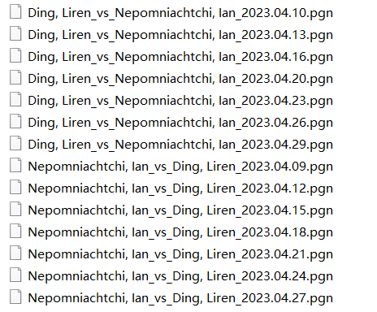
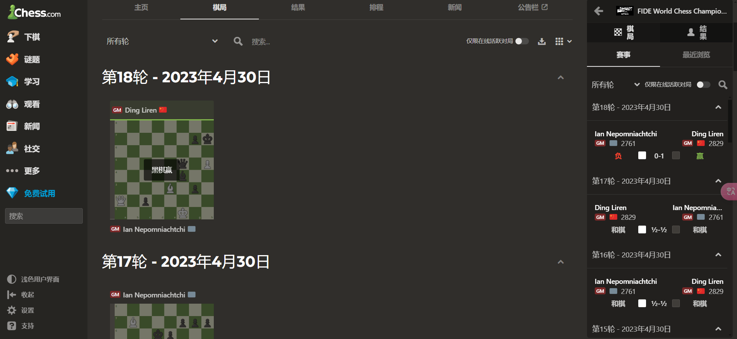
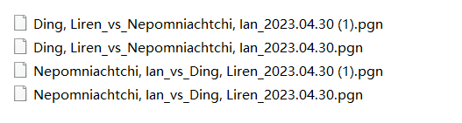
14+4

Slide 4
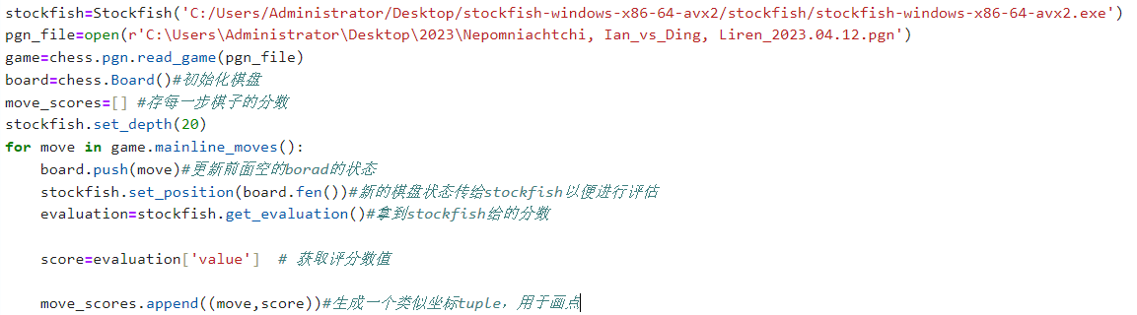
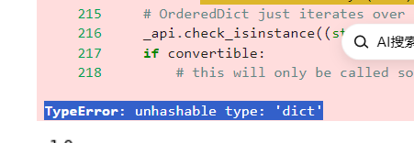
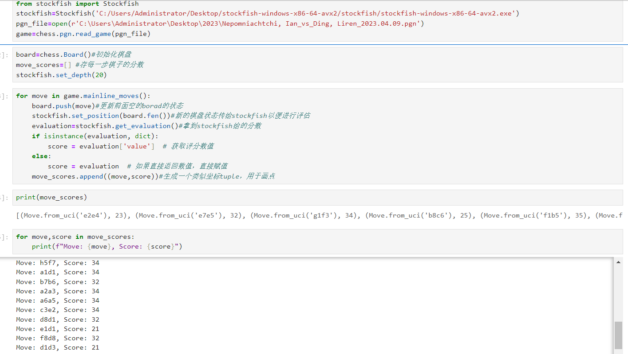
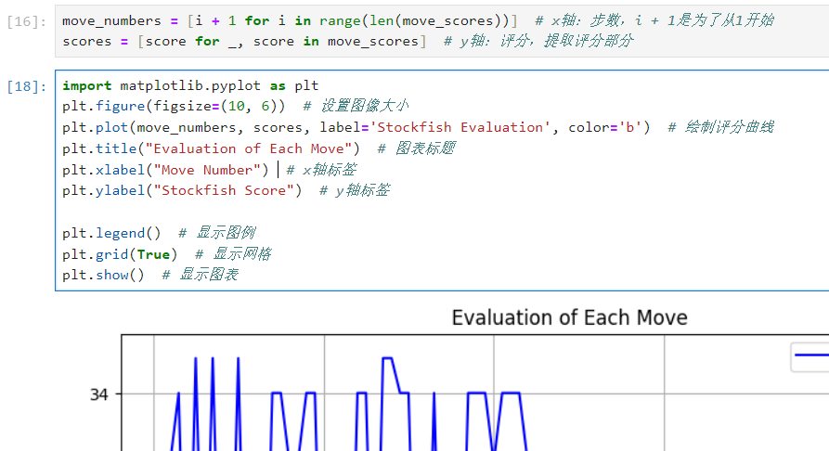

Slide 5
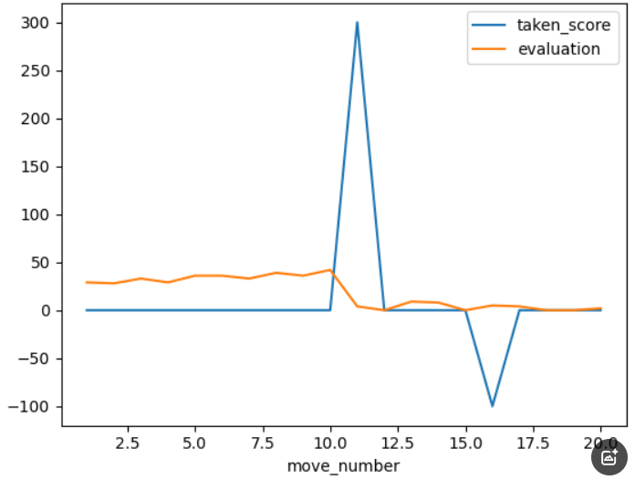
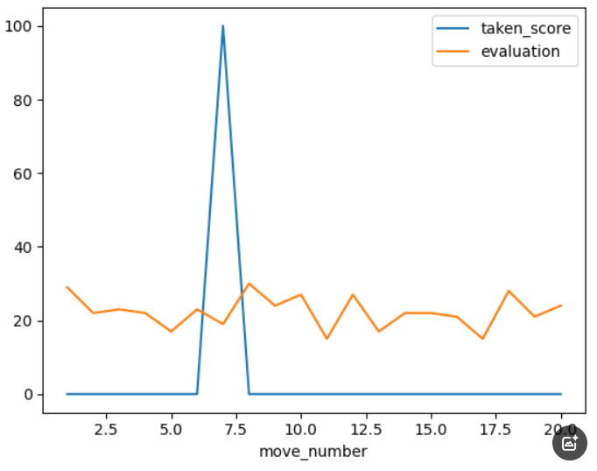
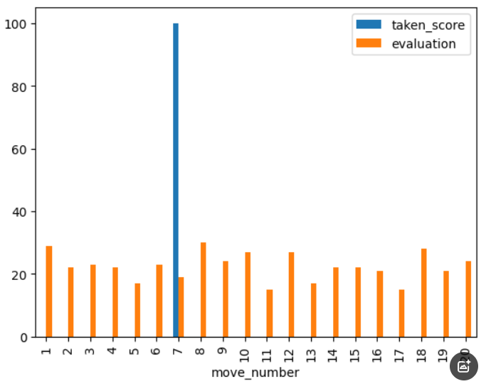
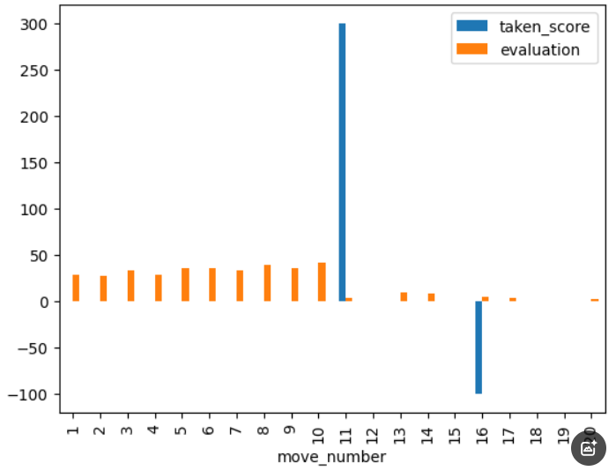
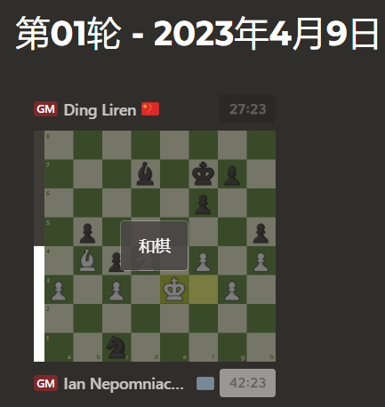
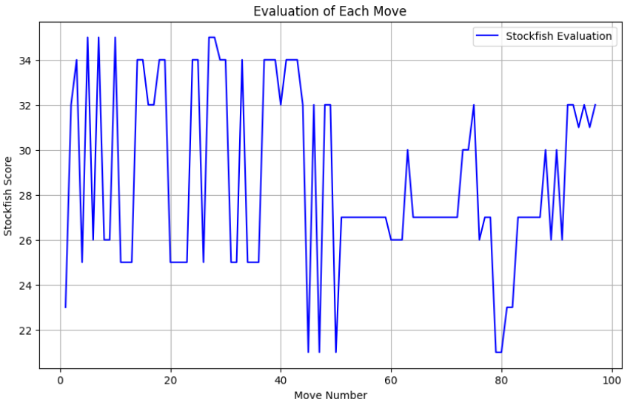
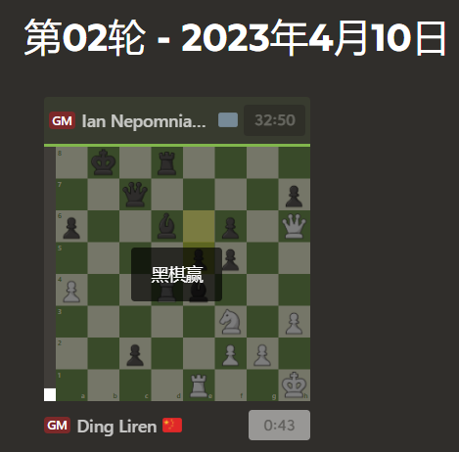
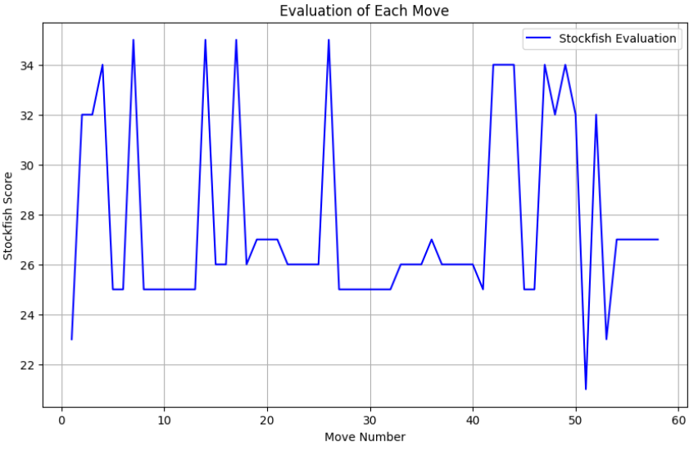
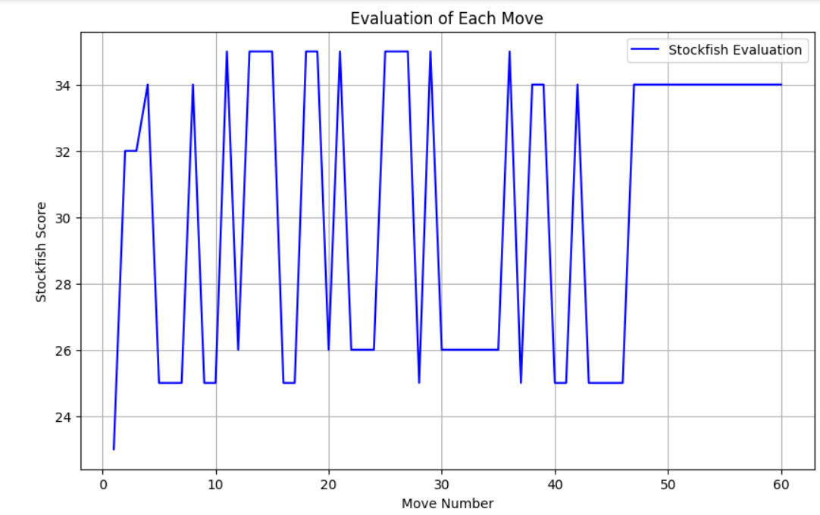
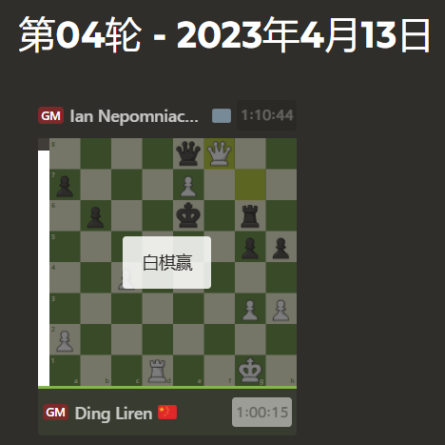
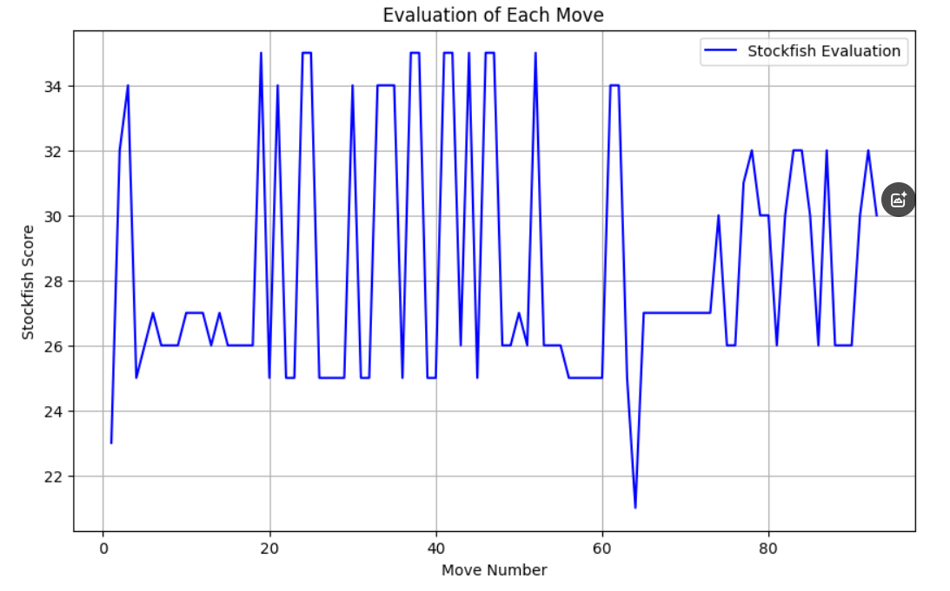
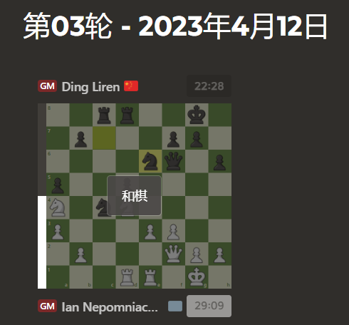
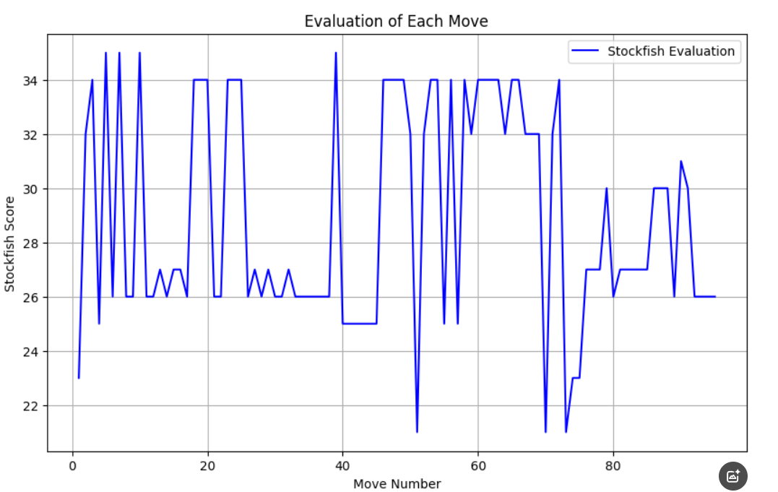
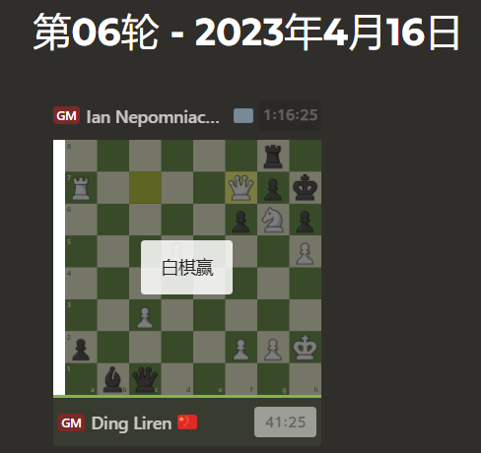
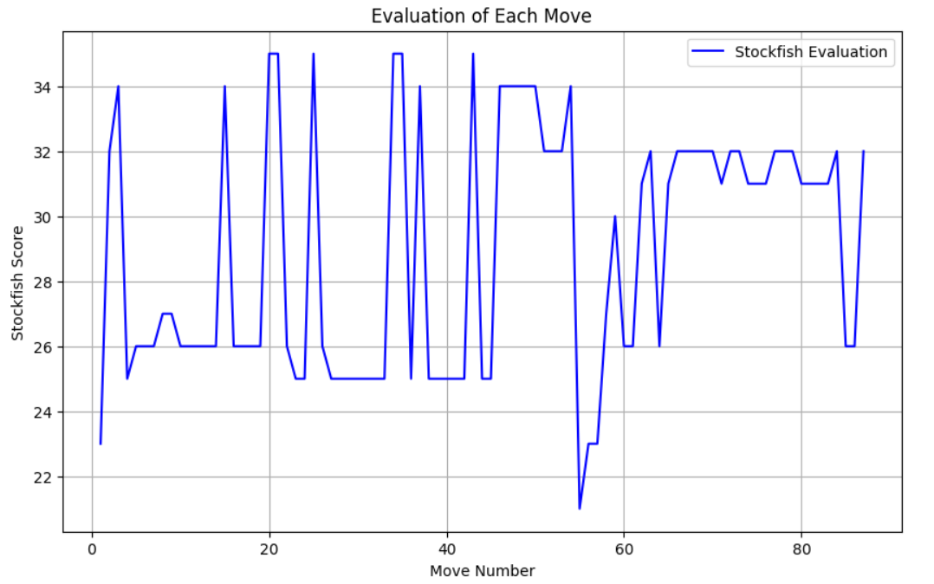
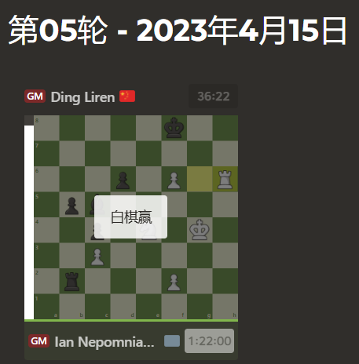
The scores are always positive

Slide 6
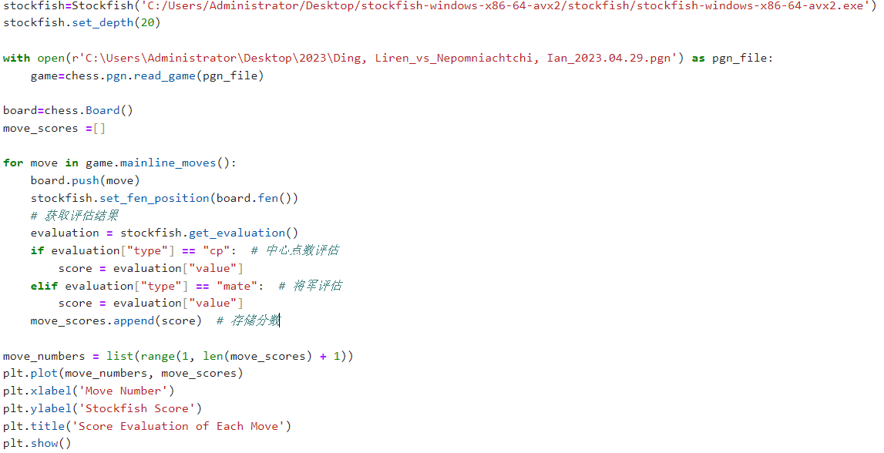
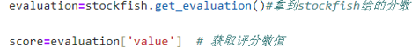
Centipawn Evaluation
Mate Evaluation
one player has a forced checkmate in a certain number of moves
{“type”:”mate”,”value”:3} white can checkmate in 3 moves.
{“type”:”mate”,”value”:-2} black can checkmate in 2 moves.

Slide 7
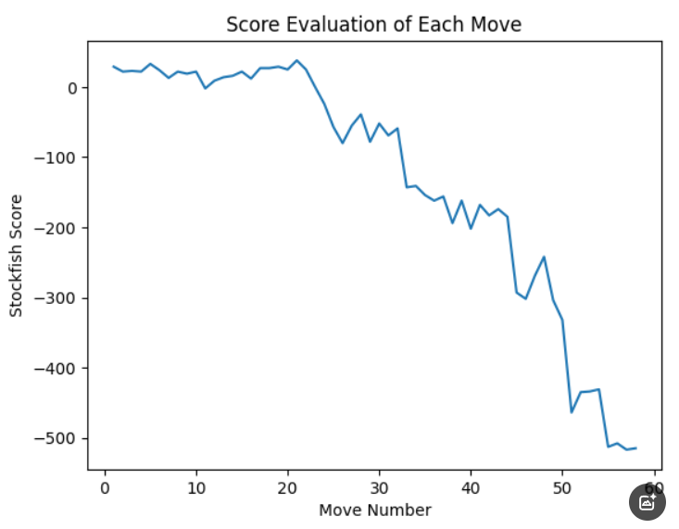
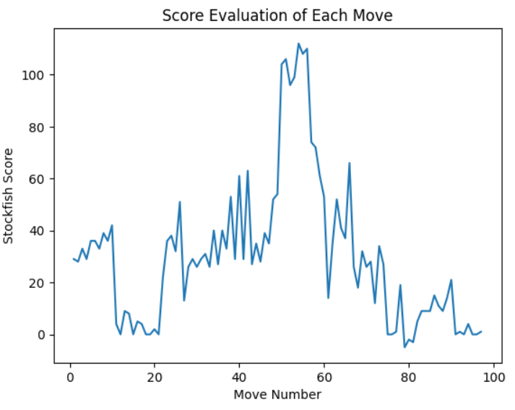
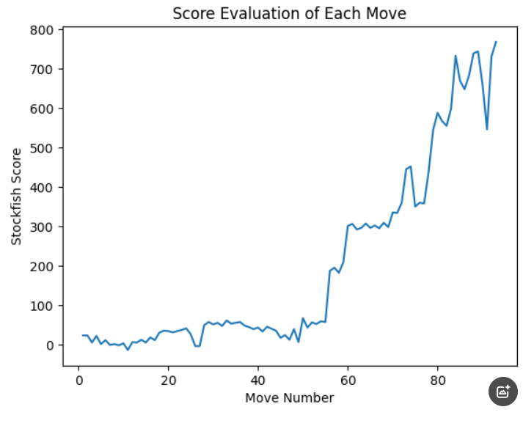
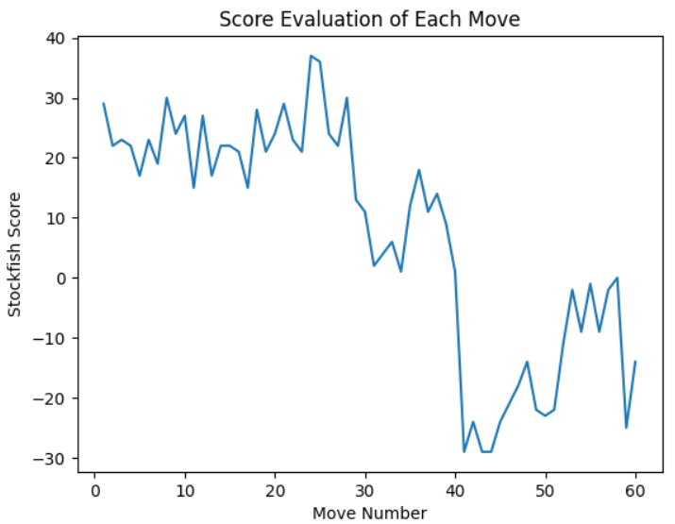
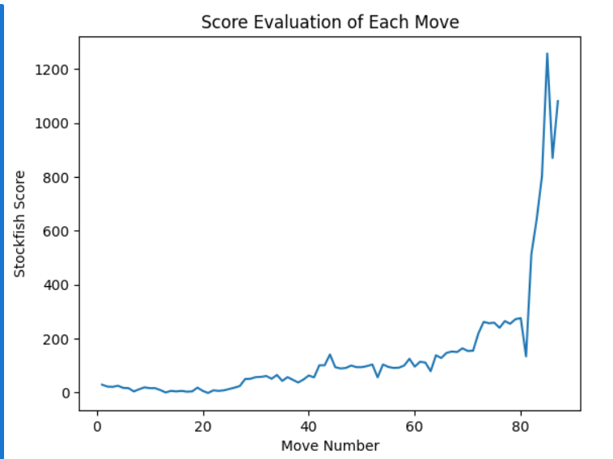
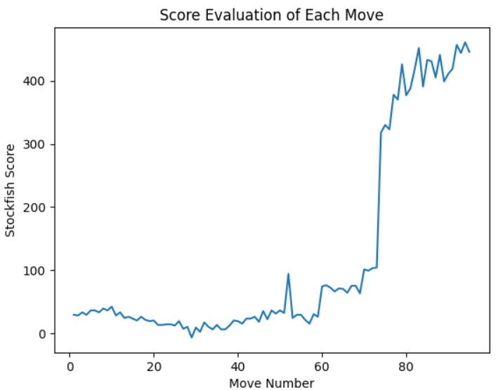

Slide 8
in both old and new codes, the final result for score is basedon evaluation["value"] .
However, the difference between them is how the evaluation type is handled, the distinction may affect the overall logic and output,especially if you don't account for the different evaluation types properly.
Why Separate Handling Matters:
Type-Specific Handling:
If you don't differentiate between cp and mate types and simply assignevaluation["value"] to score without checking the type, it could result inmisleading interpretations of the score.
For example, if the type is mate (indicating a forced checkmate), but you treat it asa cp value (which is a relative evaluation of position), you might misinterpret it as a large advantage for a player, rather than recognizing it as an imminentcheckmate.
cp Type Handling:
If evaluation["type"]== "cp" , the value directly represents the positional advantage.which is often used for creating a graph of position evaluations over time.
mate Type Handling:
lf evaluation["type"] == "mate" , the value should be treated differently because itindicates a checkmate threat, which is a game-ending situation. You wouldn't wantto plot this in the same way as a positional evaluation.

Slide 9
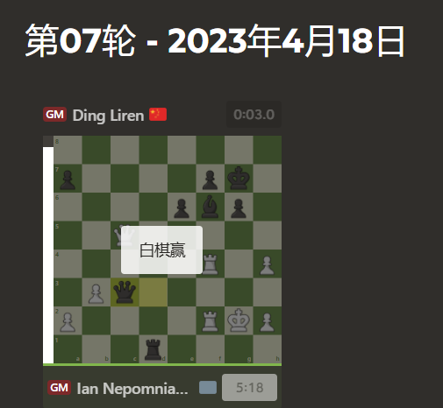
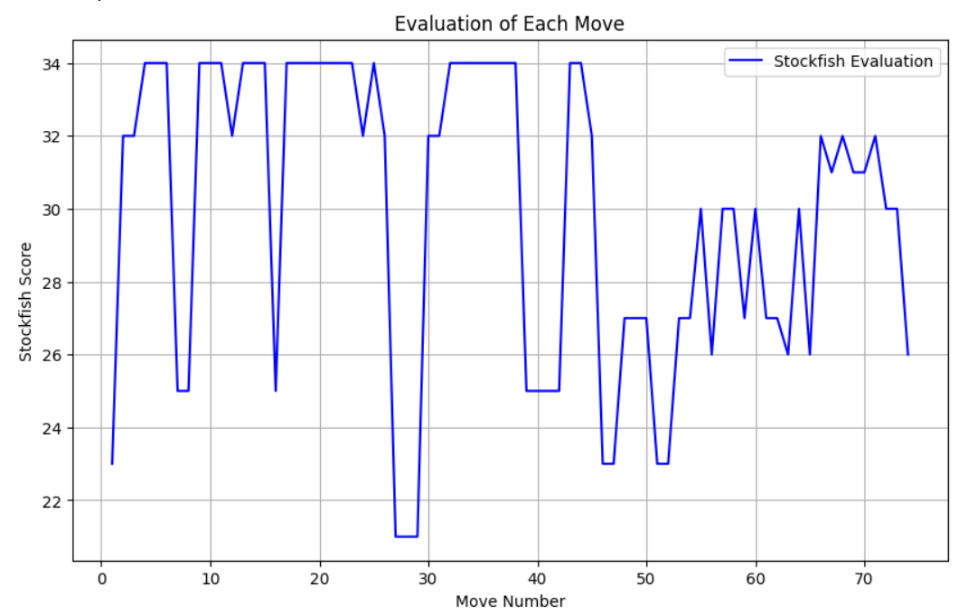
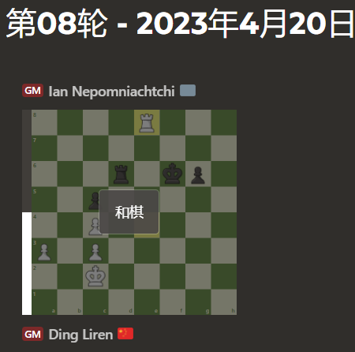
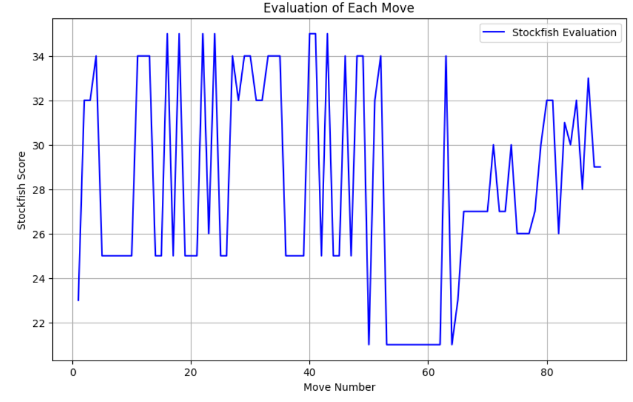
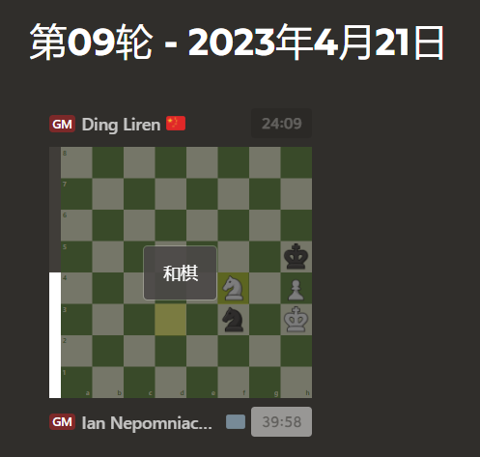
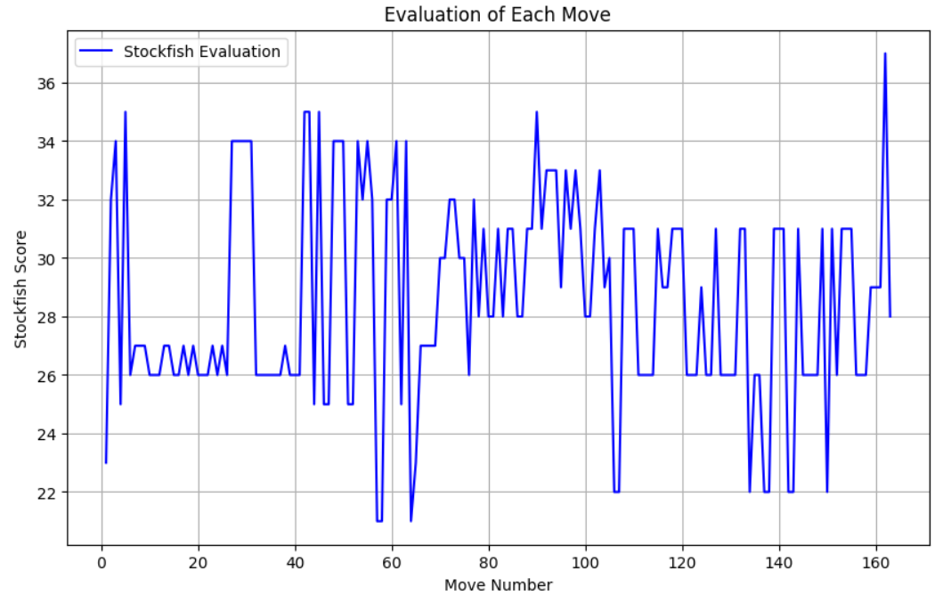
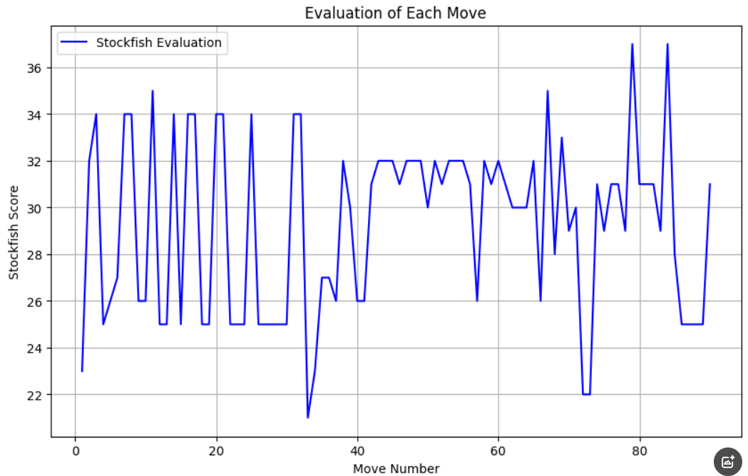
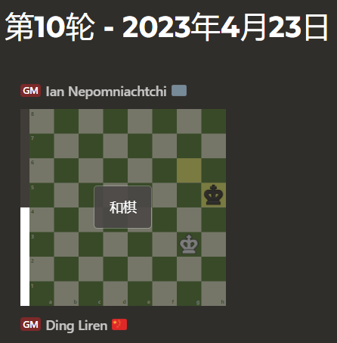
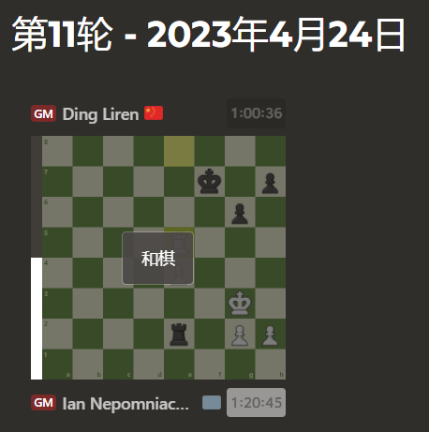
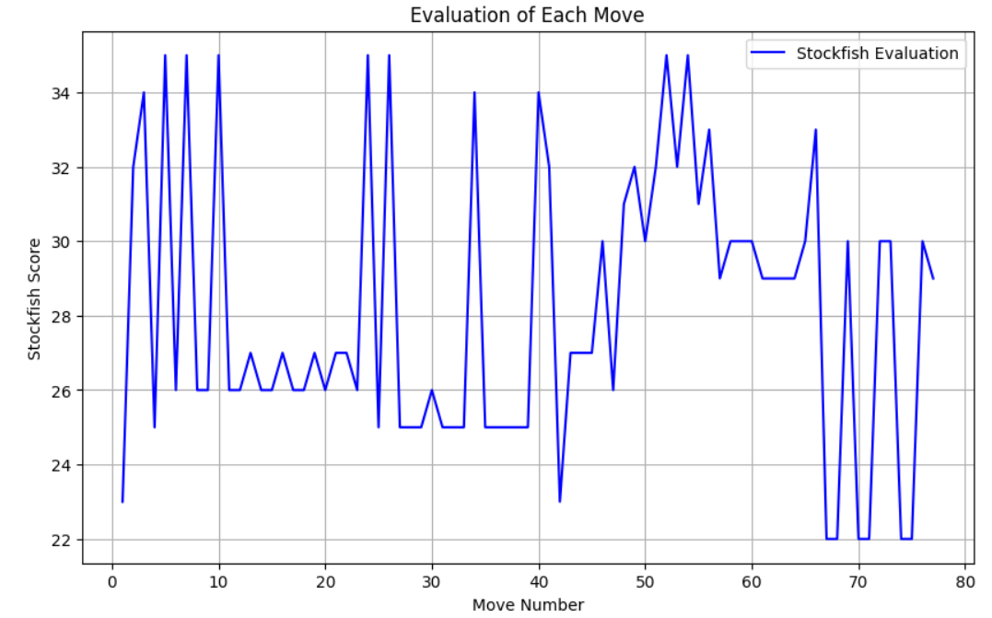
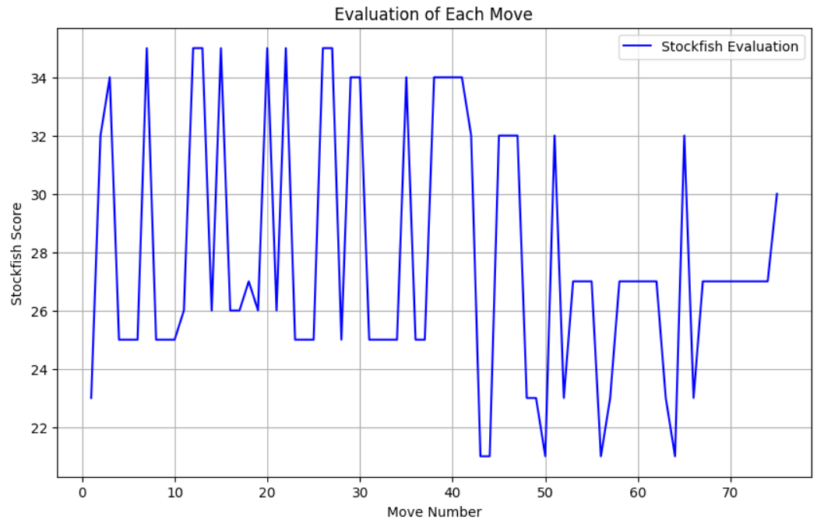
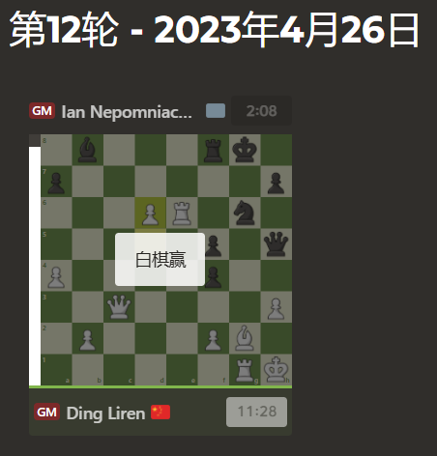

Slide 10
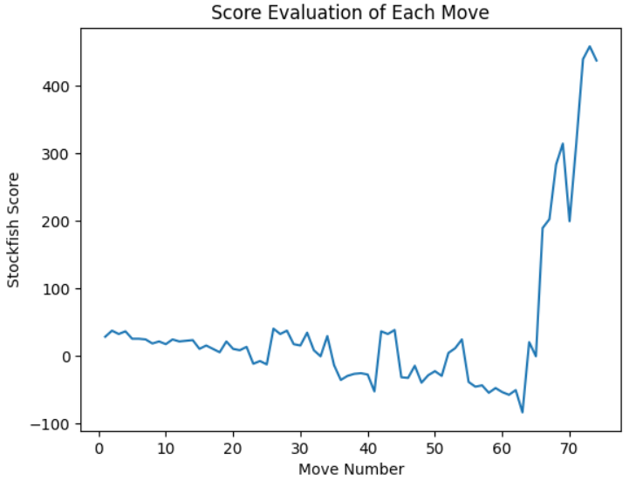
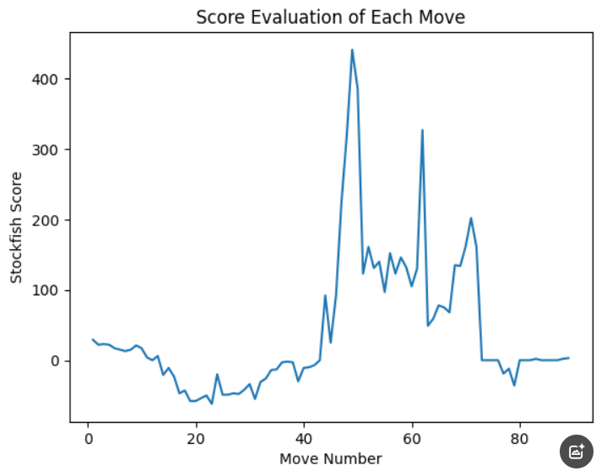
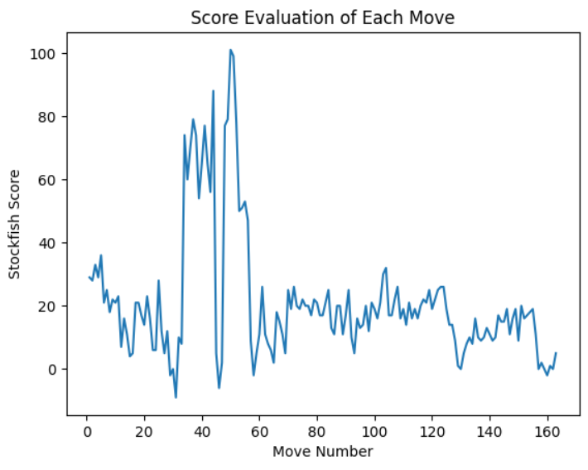
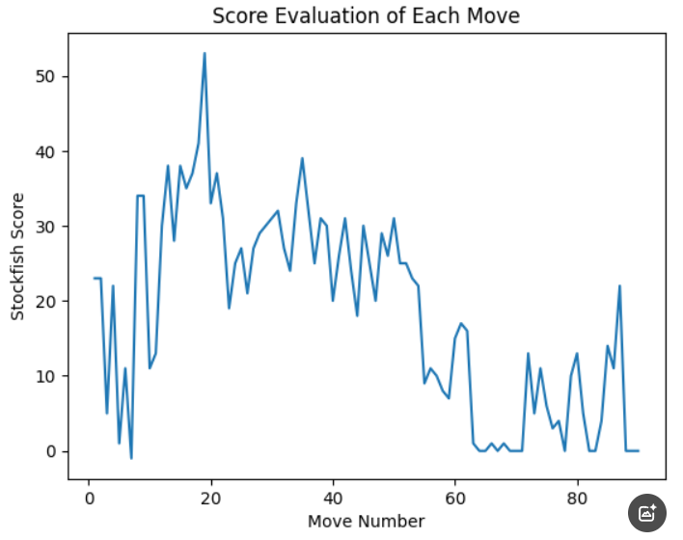



Slide 11













Slide 12







Slide 13
chess.com：惊人的Rg6 丁立人决胜时刻分析(图谱)_国际象棋_新浪竞技风暴_新浪网
chess.com棋评 :丁立人发现将杀再次追平比赛比分_国际象棋_新浪竞技风暴_新浪网
chess.com：丁立人在混乱而壮观的第12局战胜涅波_国际象棋_新浪竞技风暴_新浪网

Slide 14



Slide 15




Slide 16


